Slide 1
Integrating the Solar System
Applied Math 205 Group Activity
29-Oct-2021
Presented by:
Michael S. Emanuel

Slide 2
Physics of Gravitational Attraction

Slide 3
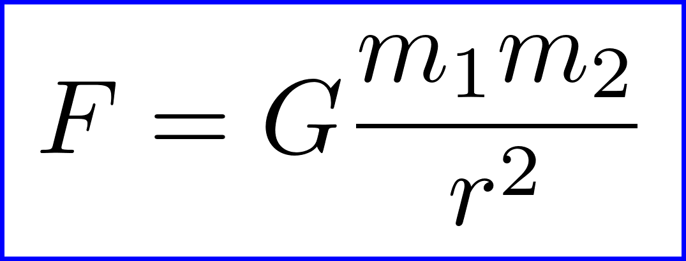

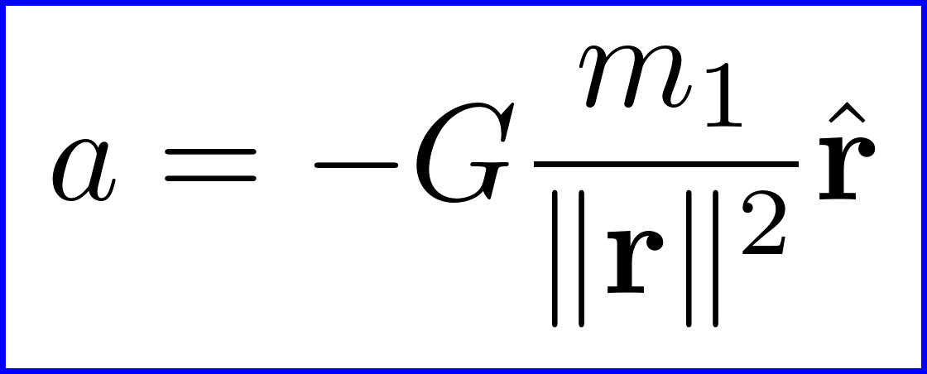
Newton’s Law of Universal Gravitation
Newton’s Law of Universal Gravitation
Newton’s Second Law of Motion
Calculate the acceleration of body 2 due to body 1
The mass m₂ cancels out

Slide 4
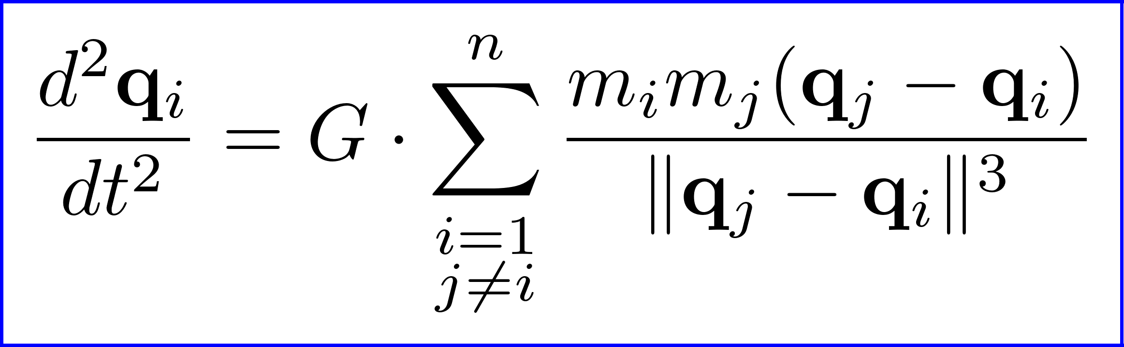
N-Body Problem Formulation
Consider n point masses of mass m_{i}, i = 1, 2, … n
Write the vector q_{i} for the position of body i
Get a coupled second order ODE for the positions
This can be solved analytically only in the case that n=2
A solution also exists for n=3 when one of the particles has zero mass

Slide 5
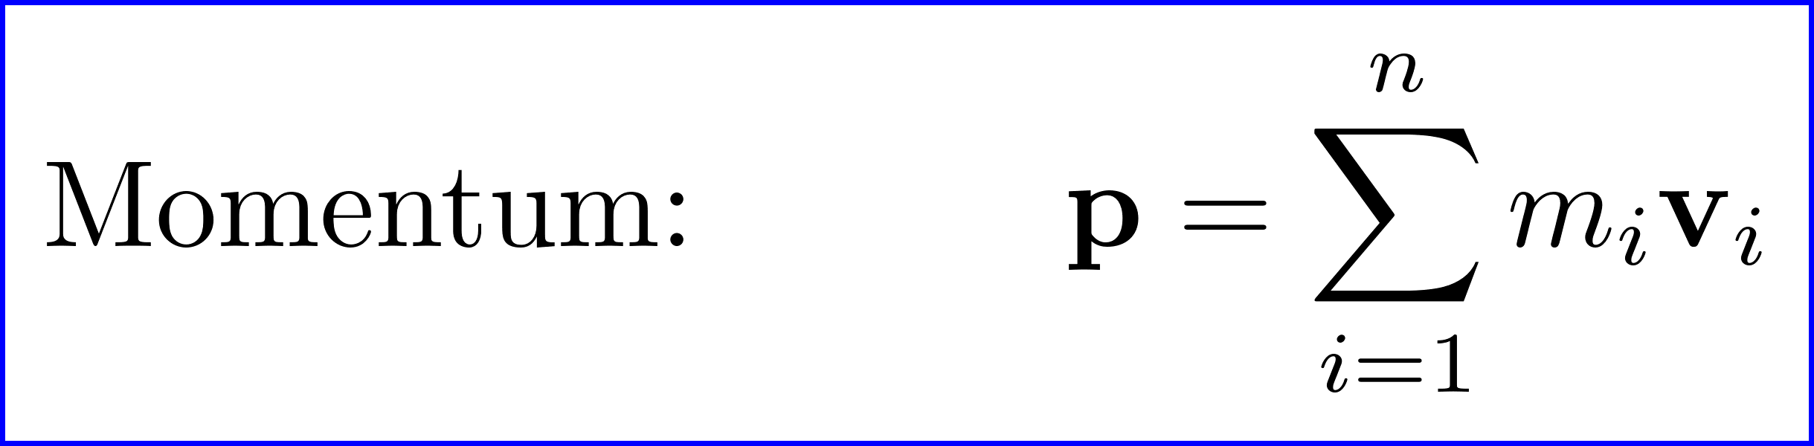
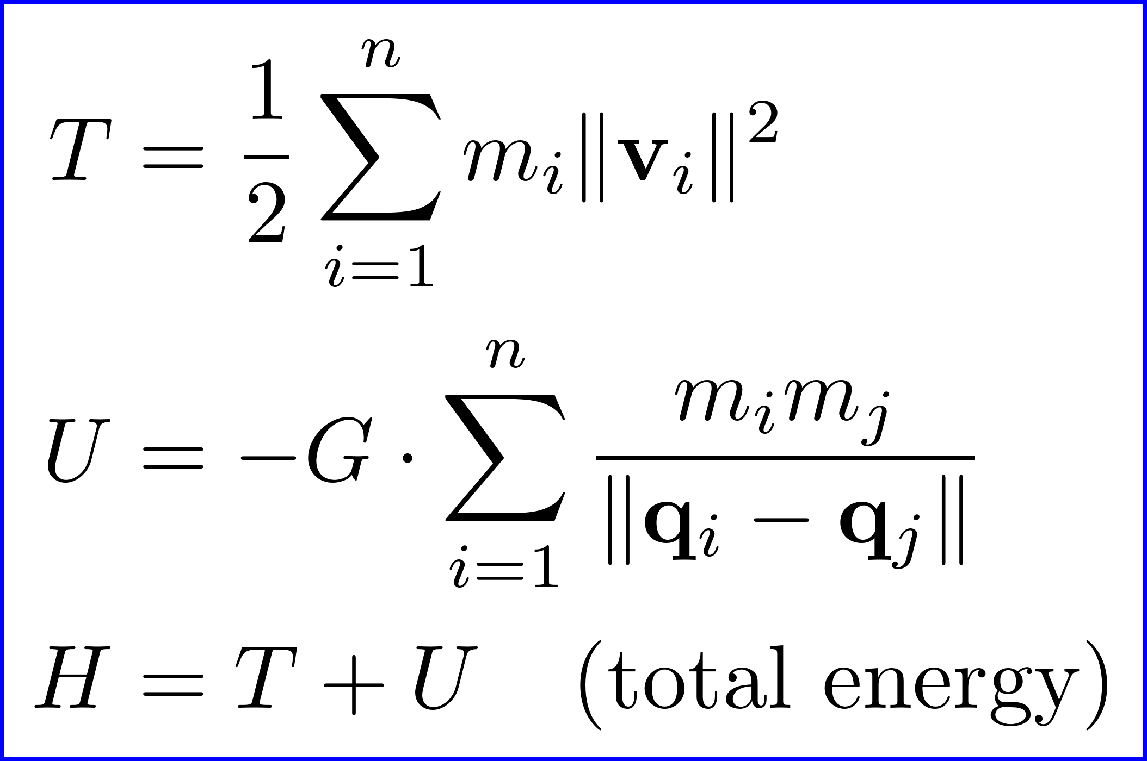
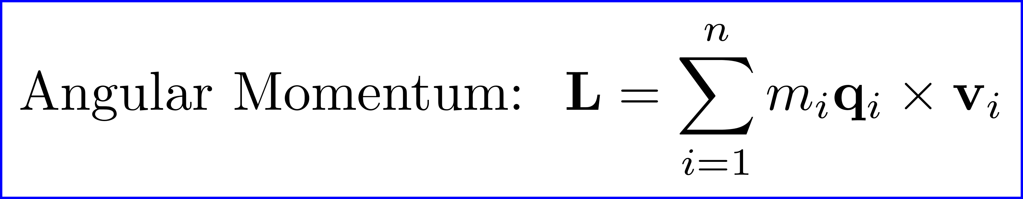
Conserved Quantities: p, L, H
The gravitational equation describes a conservative system
Important conserved quantities include momentum, angular momentum, and energy

Slide 6
Choosing an Inertial Frame and Units

Slide 7
Choosing an Inertial Frame
Momentum conservation makes it convenient to work in a frame of reference where the total momentum is zero
This is the frame of the center of mass, or “barycenter”
The Solar System Barycenter is physically defined, but how do we orient the coordinate axes?
BME: Barycentric Mean Ecliptic – use Earth’s orbit; intuitive
ICRF: International Celestial Reference Frame – modern, precise

Slide 8
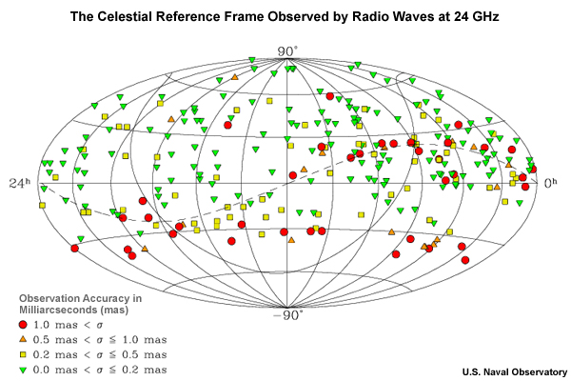
International Celestial Reference Frame (ICRF)
Notes:
Modern system for RA/Dec
Based on 232 extragalactic objects
Addresses precession and nutation
Quasars don’t move!
Not in direction anyway
Amazingly accurate
~2 milliarc-seconds
Intuition: like using Polaris instead of Earth’s axis for the North Pole
Except you use 232 stars to get a highly accurate composite direction

Slide 9
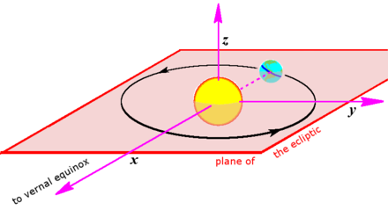
Barycentric Mean Ecliptic Frame
Convert between ICRF and BME using astropy library:
obs_icrs = astropy.SkyCoord(ra=ra, dec=dec, obstime=obstime, frame=ICRS)
obs_ecl = obs_icrs.transform_to(BarycentricMeanEcliptic)
Notes:
RA/Dec is ideal for observing the stars
But not for calculations involving orbits in the Solar System
Inside the Solar System we want an inertial frame aligned with the ecliptic: BME

Slide 10
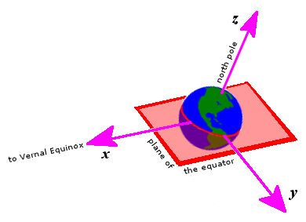
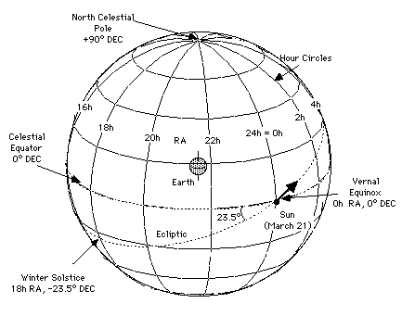
Right Ascension and Declination
Fundamental plane is aligned with Earth’s equator
Intuitive, dates to ancient astronomers
Two problems: precession (drift) and nutation (wobbles) in direction of North Pole

Slide 11
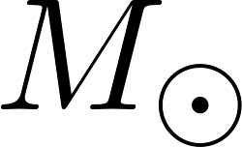
Recommend Units for Solar System Dynamics
For dynamical calculations in the Solar System, units must be chosen for mass, length, and time
SI units are great for physics… most of the time
But for Solar System problems, the scales are not convenient
A convenient set of units is based on our Solar System
Mass: a conventional figure for the mass of the sun
Length: the astronomical unit; the average distance Sun to Earth
Time: one day (86,400 seconds)

Slide 12
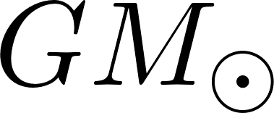
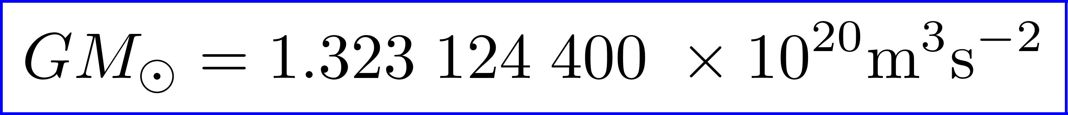
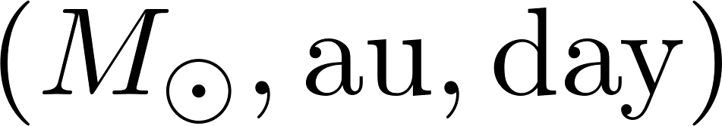
Astronomical Units and Solar Masses
The astronomical unit (au) was historically defined as the mean distance from Sun to Earth
Modern definition:
The solar mass is approximately
The solar mass parameter is easier to measure
One day is conventionally defined as 24 x 60 x 60 = 86,400 seconds
The gravitational constant G (per JPL) in units is

Slide 13
Modified Julian Dates (MJDs)
Astronomy has its own unique conventions for times and dates
Need a simple linear scale allowing for easy subtraction of datetimes that are far apart
A Julian period is the product of three cycles:
28 (solar cycle) x 19 (lunar cycle) x 15 (indiction cycle) = 7980 years (!)
This made it possible to correctly assign the year to ancient historical events
The Julian day: # days since Julian period that began at 12:00 January 1, 4713 BC
Since this is cumbersomely large, the Modified Julian Date (MJD) is defined as
MJD = JD – 2400000.5
The epoch of the MJD is 0:00 November 17, 1858
To convert between a JD and a Unix time use
UnixTime = (JD – 2440587.5) x 86400
Better idea… NEVER write these formulas yourself! Understand them once, then use a library for actual calculations.
The MJD of today’s date (29-Oct-2021) is 59516

Slide 14
Two Body Problem: Analytic Solution

Slide 15
Kepler’s Laws of Planetary Motion
The orbit of a planet is an ellipse with the Sun at one focus
A line segment joining a planet and the Sun sweeps out equal areas during equal intervals of time
The square of a planet’s orbital period is proportional to the cube of the length of the semi-major axis of its orbit

Slide 16
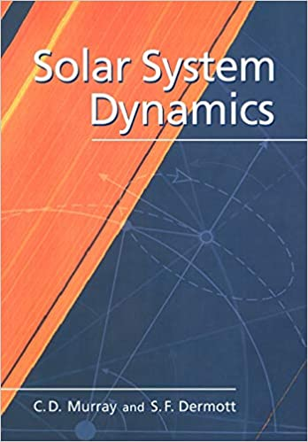
Reference Text: Solar System Dynamics

Slide 17
Aside: Definitive Books > Wikipedia
Here is a random aside I wanted to share with you
This is something I learned in graduate school in my forties
So it’s not entirely obvious
Wikipedia is amazing-free, convenient, high quality
But… it is not the most definitive source of knowledge in the world
If you are doing serious work in a field, spend some time trying to determine whether there are any “classical” or definitive text
In the case of integrating the solar system, Solar System Dynamics (C.D. Murray and S.F. Dermott) is the acknowledged classic
You will also see it cited in the rebound software documentation

Slide 18
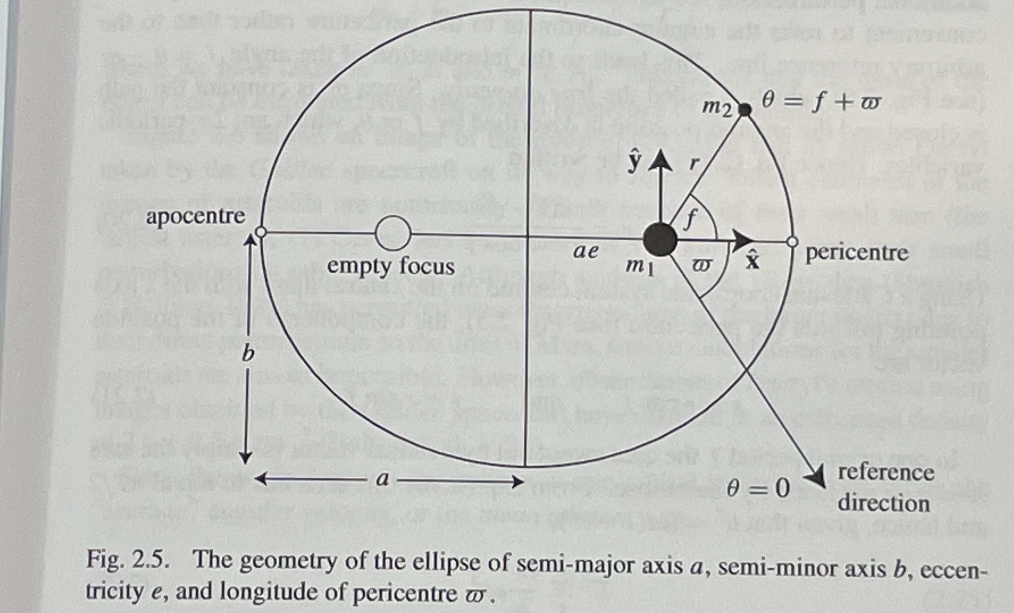
Relative Motion is Elliptical

Slide 19
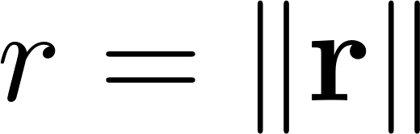
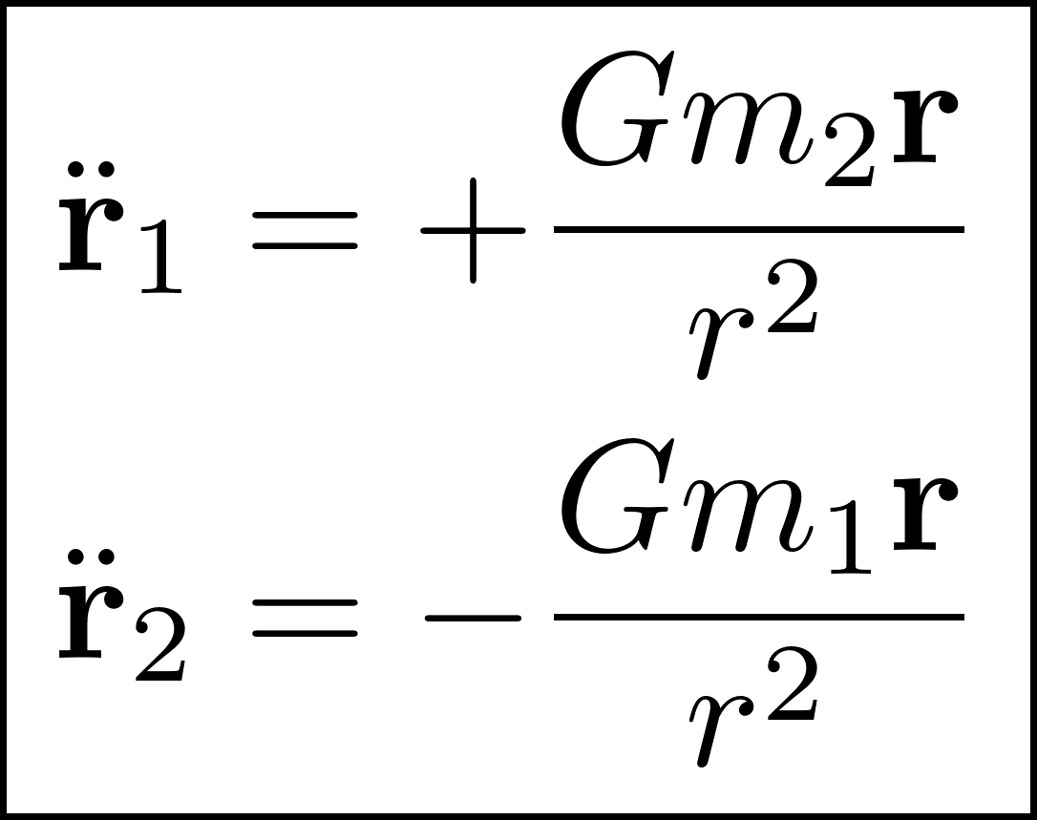
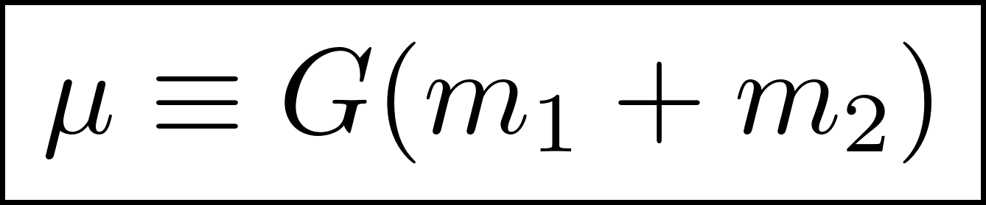
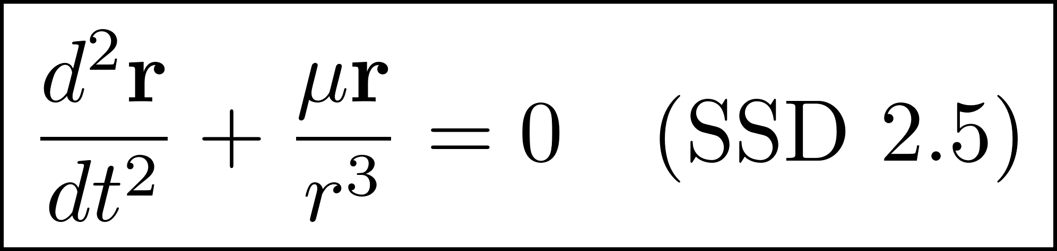
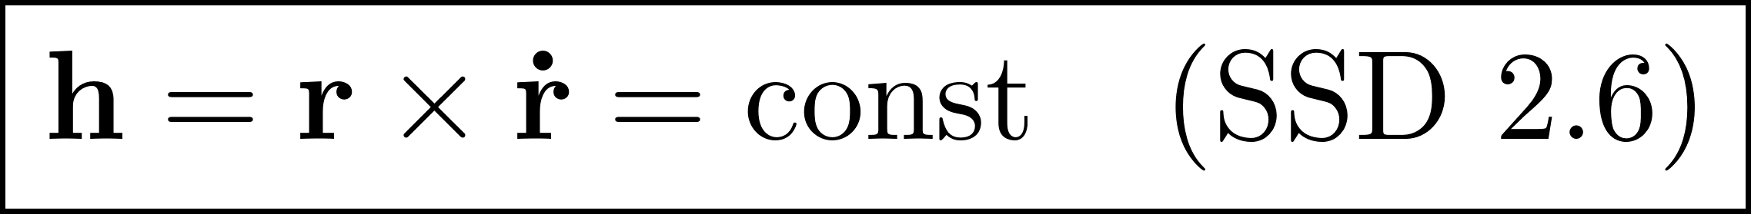
Two Body ODE- Cartesian Coordinates
Let r₁ and r₂ be positions of two bodies with masses m₁ and m₂
Let r = r₂ – r₁ be their relative displacement
Let be scalar distance between them
Specific angular momentum is conserved:

Slide 20
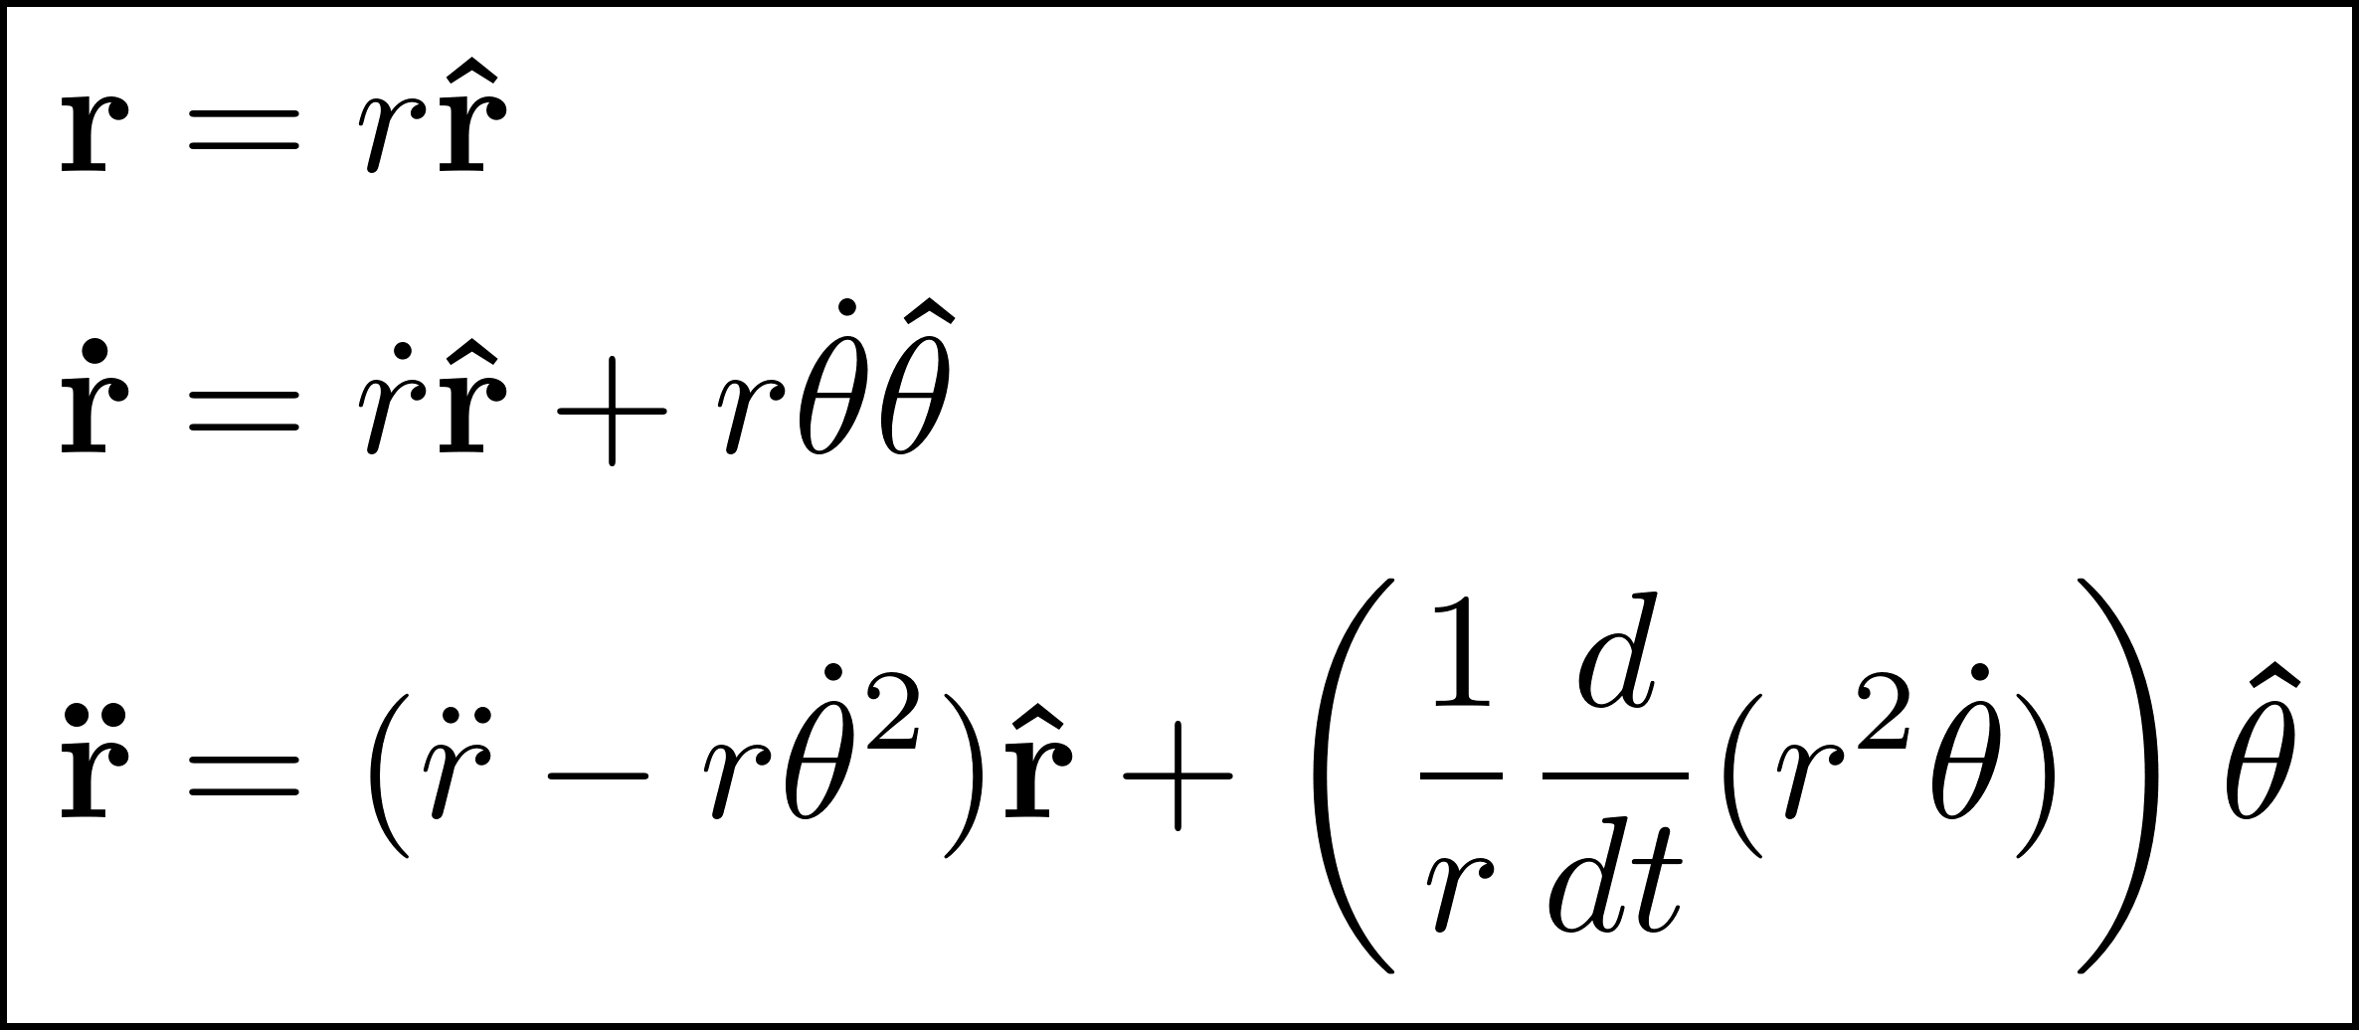
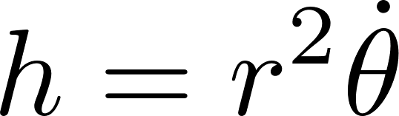
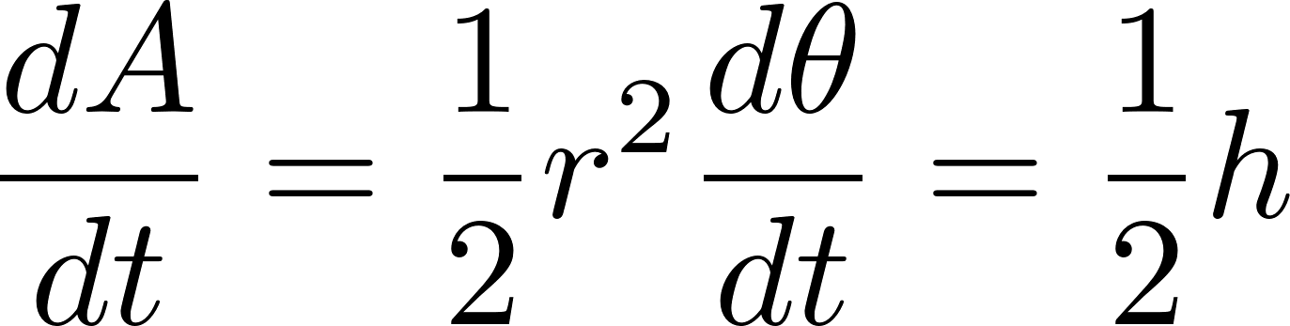
Two Body ODE – Polar Coordinates
Switch from Cartesian to polar coordinates (SSD 2.7)
Specific angular momentum conservation:
Kepler’s Second Law true for any central force:

Slide 21
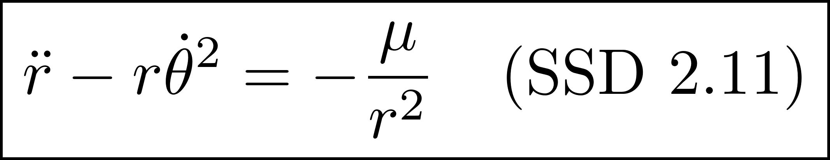
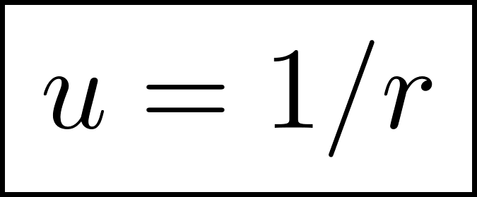
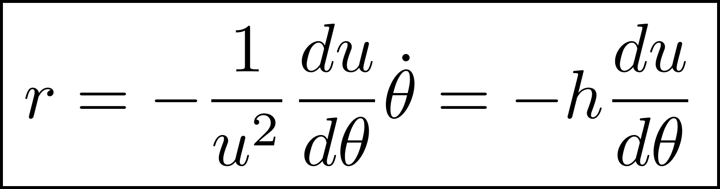
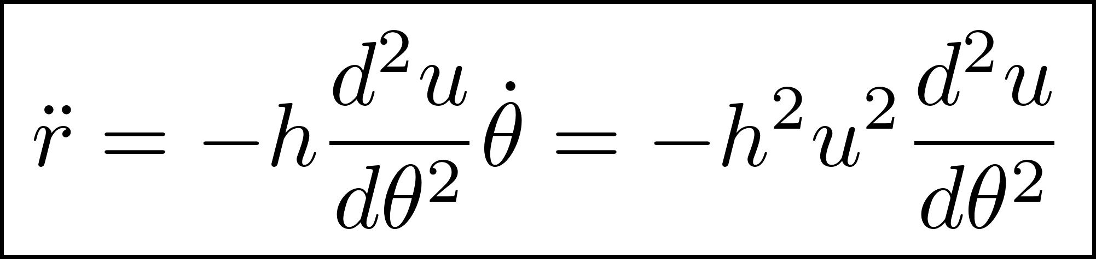
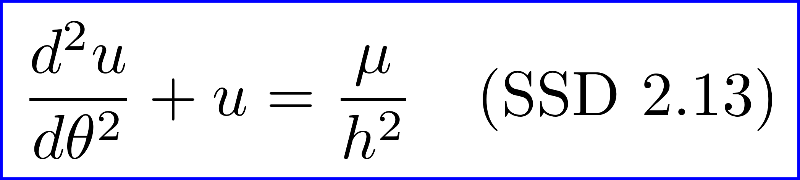
Two Body ODE – Reciprocal Distance
Match radial components in SSD 2.5
Introduce substitution and use constant
Differentiate r with respect to time twice to get SSD 2.12
Transformed version of SSD 2.11 in terms of u

Slide 22
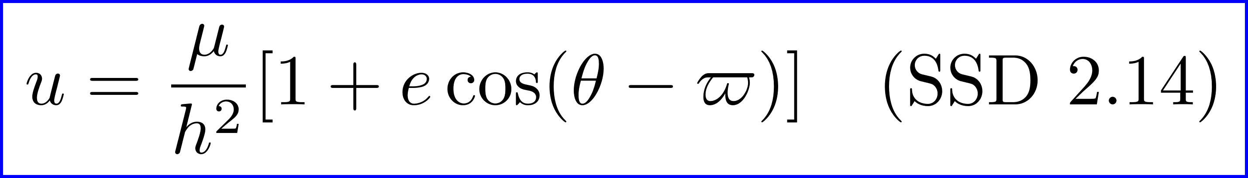
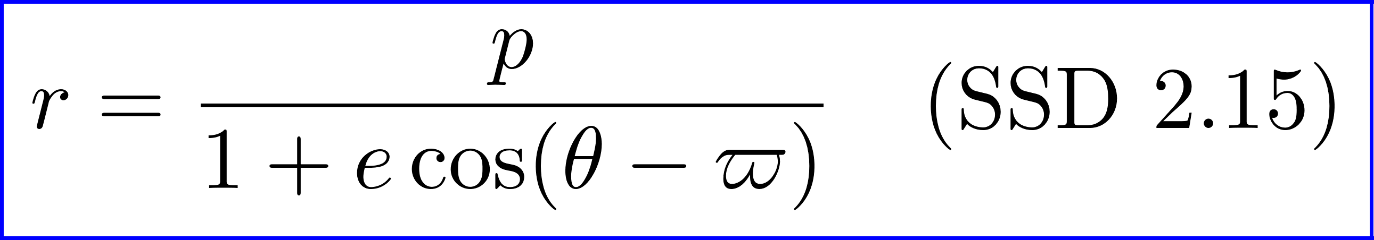
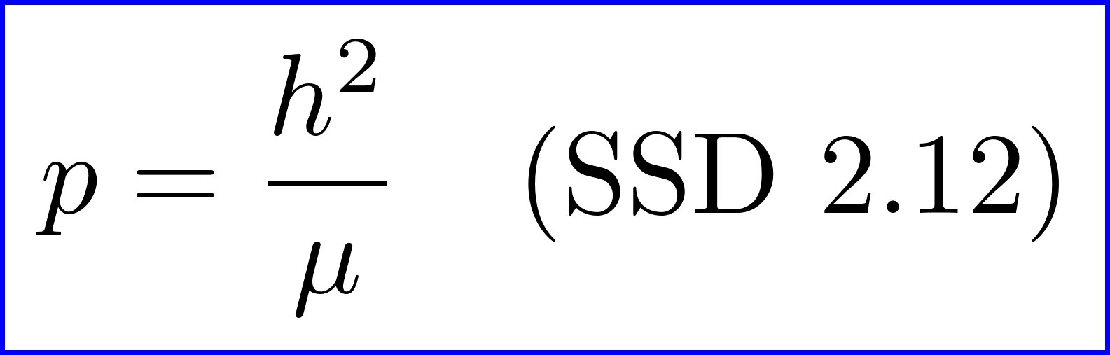

Two Body ODE – Solution
Equation SSD 2.13 has an analytical solution!
Express solution in terms of radial distance r
p is called the semi-latus rectum
e is called the eccentricity
is called the longitude of pericenter

Slide 23
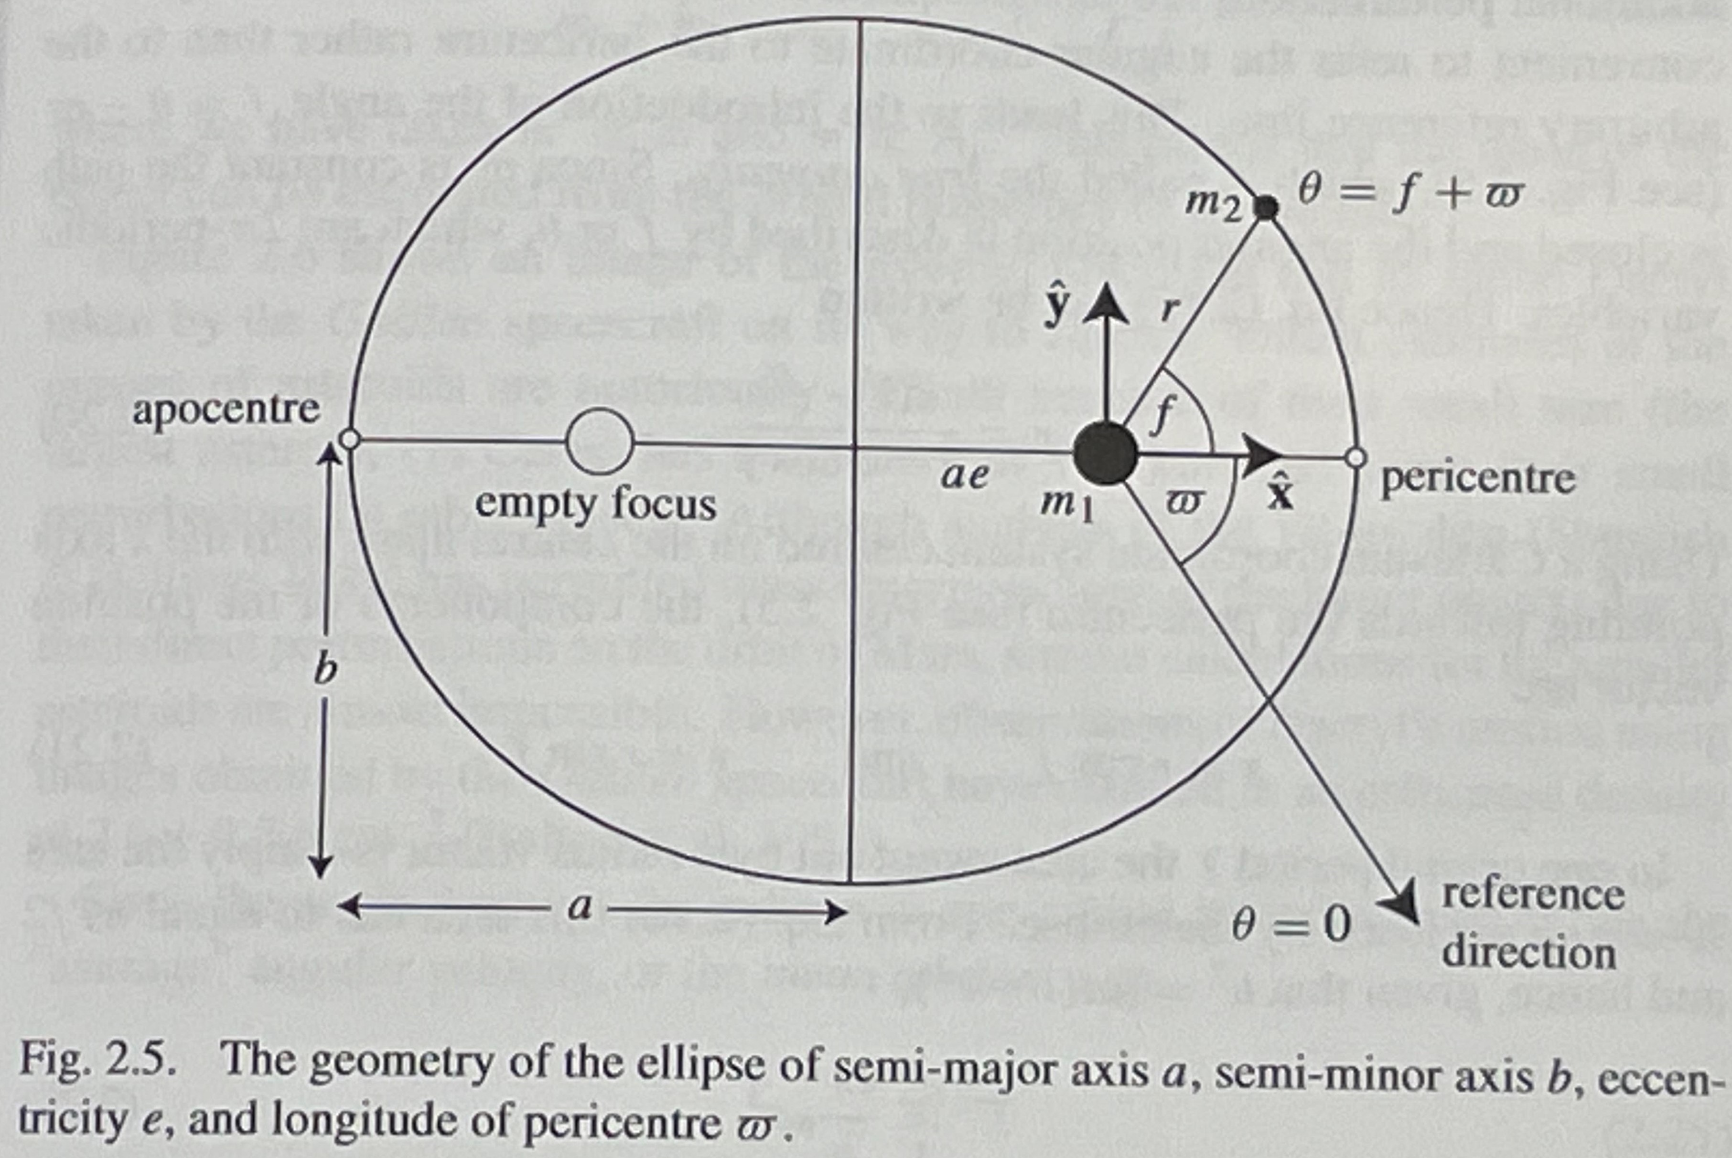
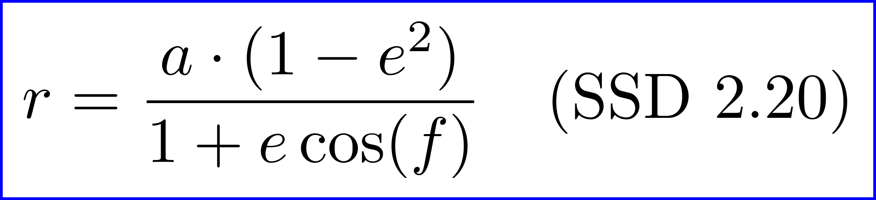
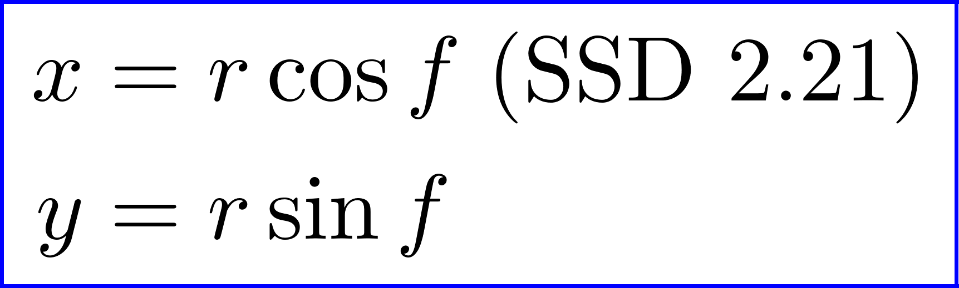
Elliptical Orbits for Two Body Solution
a is the semi-major axis
b is the semi-minor axis
Polar equation of ellipse
f is called the true anomaly
Transformation to Cartesian coordinates
When f=0, r = a(1-e) ; called pericenter
When f=π, r = 1(1+e) ; called apocenter
Fastest at pericenter, slowest at apocenter
Semi-major axis a sets size of ellipse
Eccentricity e sets how elongated it is
f controls position along the orbit

Slide 24
Keplerian Orbital Elements

Slide 25
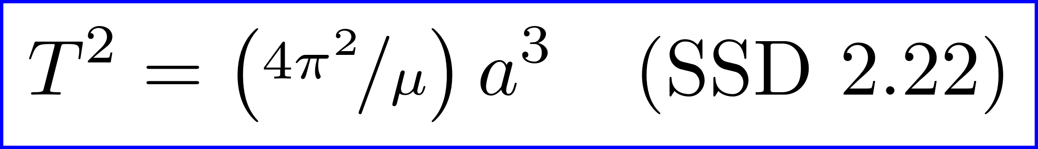
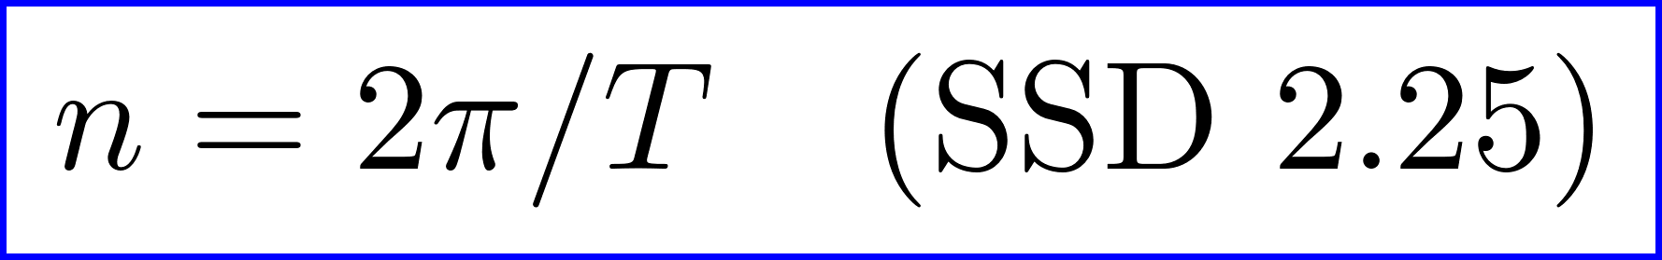

Mean Motion n and Mean Anomaly M
The orbital period T is
Consistent with Kepler’s Third Law!
Angle θ sweeps out 2π radians per orbital period T
Define the mean motion n as average angular velocity
n also relates to μ and specific angular momentum h via
Define the mean anomaly M as a fictitious angle that’s linear in time
τ is called the time of pericenter passage and a constant

Slide 26
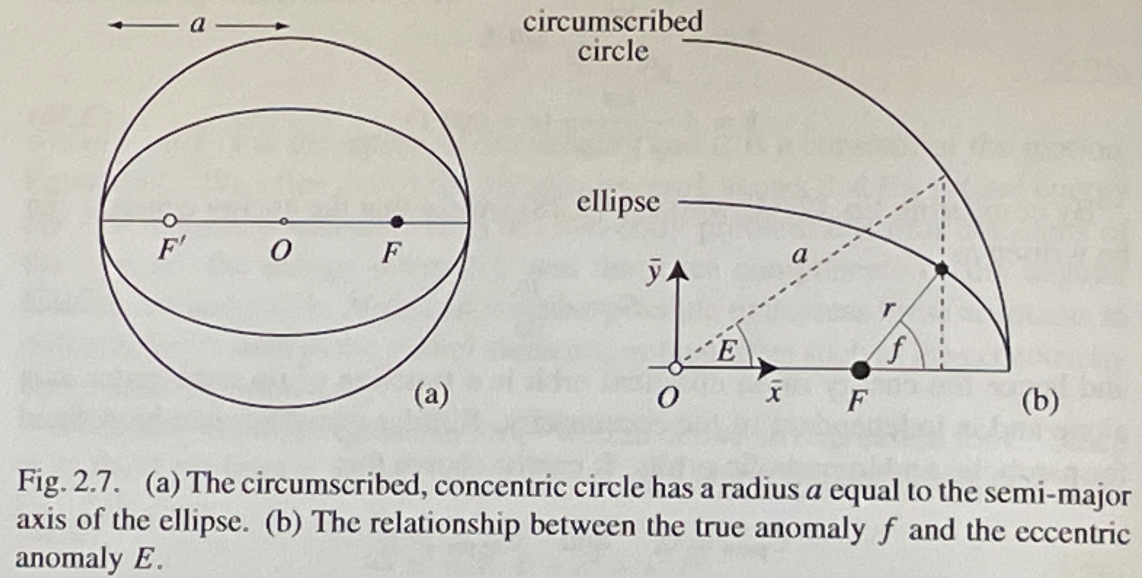
Eccentric and True Anomaly

Slide 27
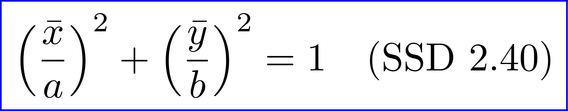
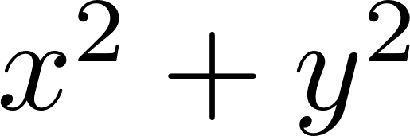
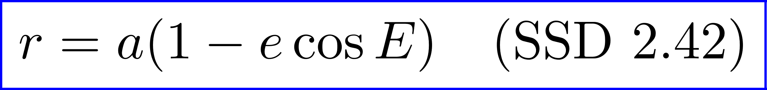
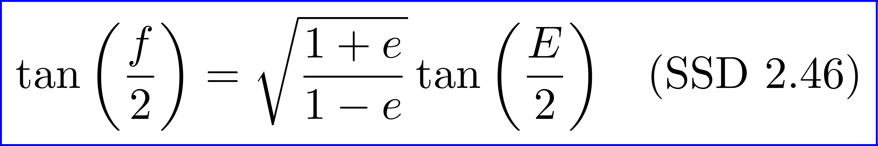
Eccentric Anomaly Equations
Centered ellipse equation
Cartesian coordinates from a and E
Distance r from a, e and E (Do )
Relationship between E and f – useful!

Slide 28
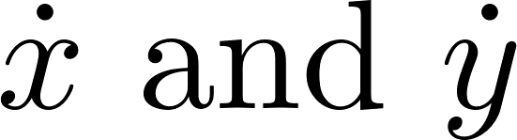

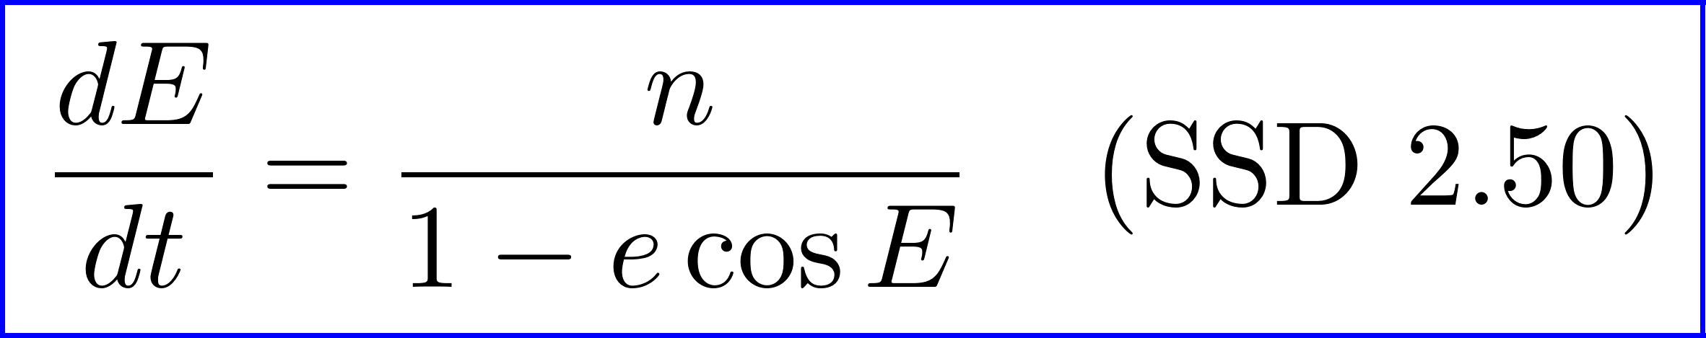

Kepler’s Equation: Relating M and E
Calculate from SSD 2.41, then compute
The magnitude of this is equal to h; use SSD 2.26 and
Integrate this and match the boundary condition E=0 at t=τ and
This is the famous Kepler’s Equation
Kepler’s Equation cannot be solved analytically for E as a function of M
But it can be solved numerically efficiently using Newton-Raphson
This method allows us to compute two orbits as a function of time!

Slide 29
Orienting the Orbit in Space
We’ve perfectly solved the two body problem in its orbital plane
The orbit is described by 3 elements: a, e, f
If you only wanted the orbit of one body around the Sun, you could choose the frame so the ecliptic was the XY plane
But there are many bodies of interest in the Solar System all orbiting in different planes
We would like a formalism to permit us to orient our planar 2D orbits into 3D space with one preferred frame (e.g. BME)
This is what the remaining orbital elements i, Ω, ω do

Slide 30
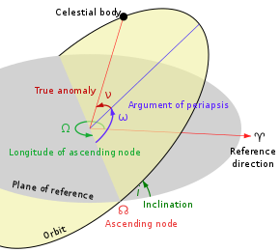
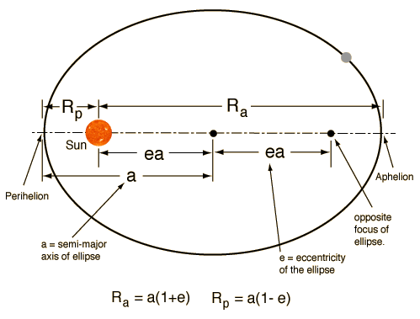
Keplerian Orbital Elements
Image Credits: WikiPedia, Cool Cosmos
Semi-major axis a and eccentricity e describe the size and shape of the orbital ellipse
Inclination i, ascending node Ω, perihelion ω are angles orienting orbit in the ecliptic plane
True anomaly f is location of the body on its orbital ellipse

Slide 31
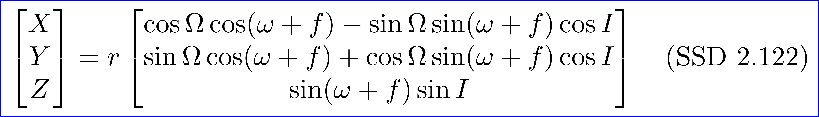
Mapping Elements to Cartesian Coordinates
The three angles define rotation matrices
The equation mapping from orbital elements to Cartesian coordinates
This can be inverted, but it’s a bit messy, and sometimes the answer is not unique (e.g. if e=0)
The most common scenario is to convert from (a, e, I, Ω, ω, f) to (q_{x}, q_{y}, q_{z}, v_{x}, v_{y}, v_{z})
It’s also possible to fit Kepler elements from Cartesian vectors

Slide 32
Three Body Solution: Analytic Solution

Slide 33
Just Kidding
Just kidding! There is no known complete analytical solution to the full Three Body Problem
There is a beautiful solution to the Restricted Three Body Problem
That has two massive bodies (think Sun and Jupiter) and solves for the motion of a massless “test particle” (think Earth, approximately)

Slide 34

The Three-Body Problem: Sci Fi

Slide 35
N-Body Problem: Numerical Solution with Rebound

Slide 36
Reality Check: Numerical Integrators!
The analytical solution to the two body solution is elegant
It’s historically important and gives useful, fast approximations for the Solar System, but…
Reality check: if you want Solar System orbits “for real” and not on a school homework problem…
You are going to do it numerically on a computer!
While Python odeint is a good general purpose tool…
Gravitational N-body integrators are a well studied problem with highly optimized packages available

Slide 37
REBOUND Integrator for N-Body Problem
REBOUND is a modern, open source integrator
It numerically solves the gravitational N-body problem
IAS15 adaptive integrator uses Gauss-Radau quadrature and a “predictor-corrector” scheme
github.com/hannorein/rebound and PyPI
Horizons: API provided by NASA JPL to obtain state vectors (position and velocity) of objects in the Solar System
Considered “gold standard” for initial conditions of an integration

Slide 38
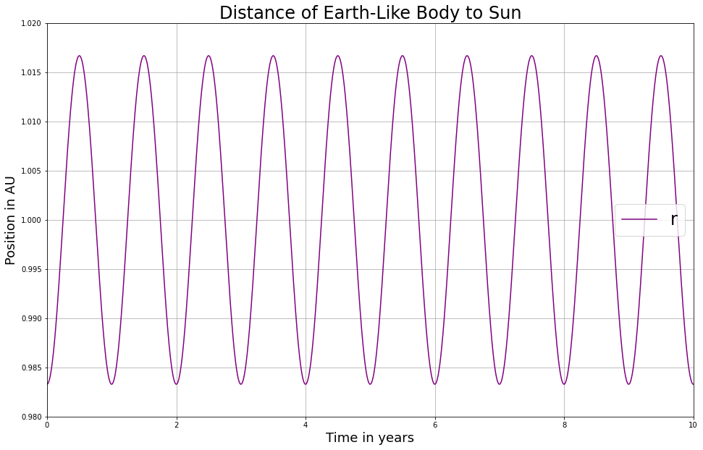
First Simulation with Rebound
See 01-GetStarted.ipynb
Key statements:
import rebound
sim = rebound.Simulation()
sim.units = (‘day’, ‘AU’, ‘Msun’
sim.add(m=1.0)
sim.add(m=3.003E-6, a=1.0, e=0.0167)
sim.integrate(t, exact_finish_time=1)
sim.serialize_particle_data(xyz=q[i])

Slide 39
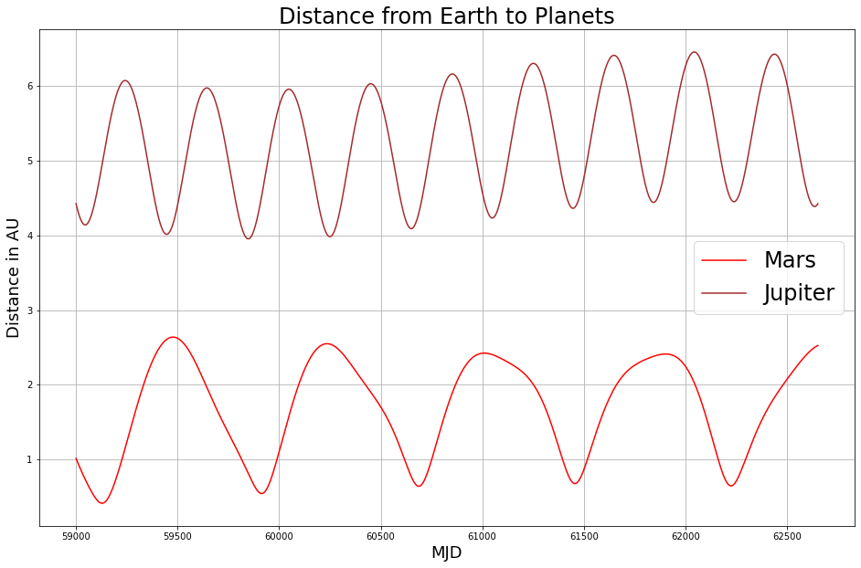
Getting the Initial Conditions from Horizons
See 02-Planets.ipynb
Key statements:
body_names = [‘Sun’, ‘Earth’,
‘Moon’, ‘Jupiter Barycenter’…]
date = ‘JD240059000.5’
sim.t = 59000.0
sim.add(body, date=date)
sim.save(‘planets_59000.bin’)
sim = rebound.Simulation(
‘planets_59000.bin’)

Slide 40
Appendix
Some uses I made of REBOUND in my own research

Slide 41
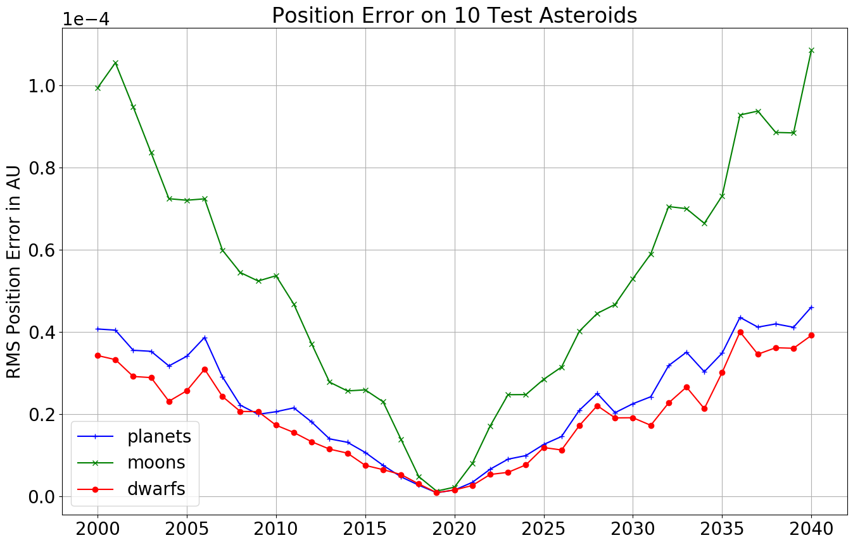

Validating Integration vs. Horizons
Integrate three massive body collections and asteroids
Error metrics: position in (AU) and instantaneous angle from asteroid to Earth (arc seconds)
Accuracy is excellent!
RMS error on planets is 5.4E-6 AU
Angle error from asteroids to planets 0.8 arc seconds
Notes:
Integrate three collections of massive bodies for 40 years at daily interval
Initial conditions from Horizons at MJD 58600 / 2019-04-27
Test results on first 10 IAU asteroids; query their positions from Horizons

Slide 42
Bulk Integration of 733,489 Asteroids
Notes:
Download asteroid orbital elements from JPL
Data available for 733,489
Integrate these daily for 40 years
Save results to disk
REBOUND simulation archives
Numpy arrays
Job takes 4:30 on 40 CPU cores
Writes 1.37 TB output to disk

Slide 43
Validate Asteroid Integration vs. Horizons
Test bulk asteroid integration on first 25 IAU asteroids
Excellent results! RMS 2.49E-6 AU and 0.45 arc seconds
Notes:
Report position error in AU and angle error to Earth in arc seconds

